Slide 1
Income Range Predictor Hackstory June 2023 (ML x Social Issues – Problem Statement 1) Predicting Income range considering biases
by Team CodeCrux

Slide 2
Problem Statement
Ml x Social Issues
Design an ML-based Income Range Predictor with Bias-Aware Integration:
Develop a machine learning solution to predict job applicants' income range based on their demographic and professional information. The solution should include a user-friendly interface, either as a website or SDK. Address potential biases to ensure fair and unbiased predictions. Conduct exploratory data analysis to understand the data, identify biases, and analyze variable relationships. Mitigate bias during model training and evaluation.
Dataset info: This dataset related to income ranges of adults. The uses of this dataset are in cases where companies may need to use an algorithm to classify job applicants into income ranges. In this data set the income column- (>50k or <=50k) are the y-labels for prediction. (Note that the data is raw and rife with issues- just as it is in real time- try your best to work through it!)

Slide 3
Objectives
Develop ML solution to predict job applicants' income based on demographic and professional data.
Create user-friendly interface (website/SDK).
Perform exploratory data analysis and address biases.
Mitigate bias during model training and evaluation.
Handle raw and problematic data.
Improve accuracy of income range predictions.
Support companies in classifying job applicants.
Enhance transparency and accountability by mitigating biases.

Slide 4
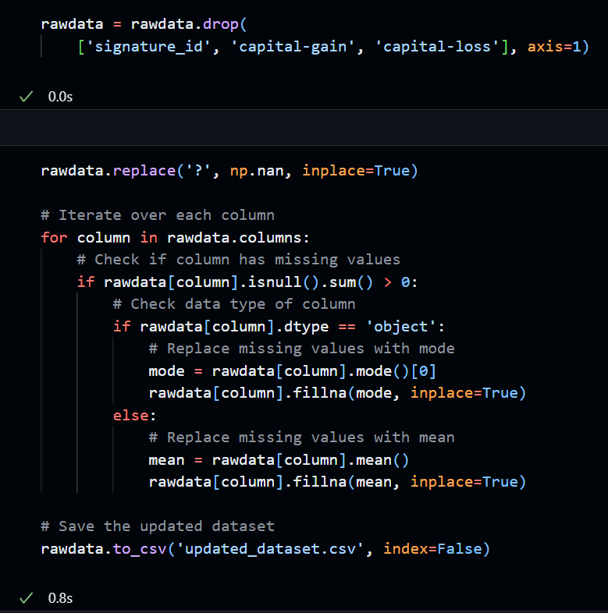
Data cleaning

Slide 5
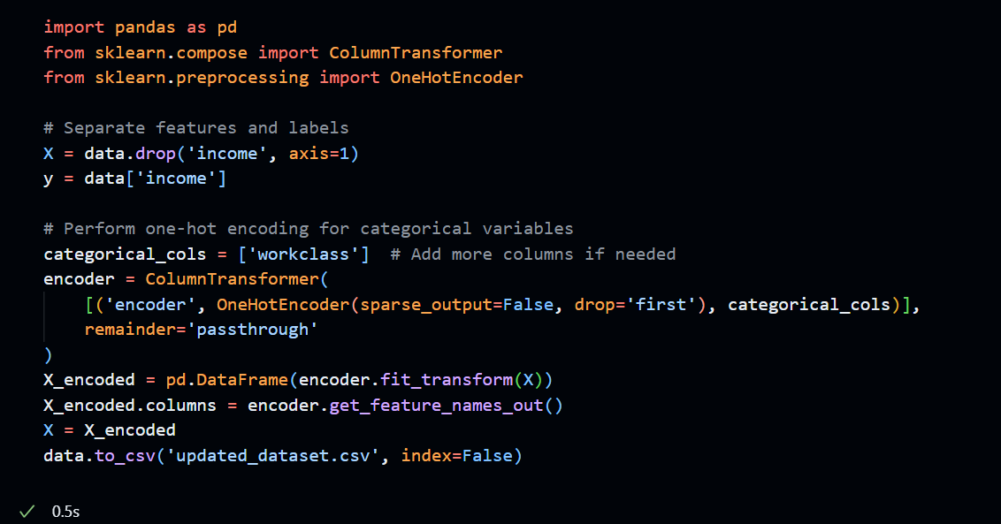
Encoding data

Slide 6
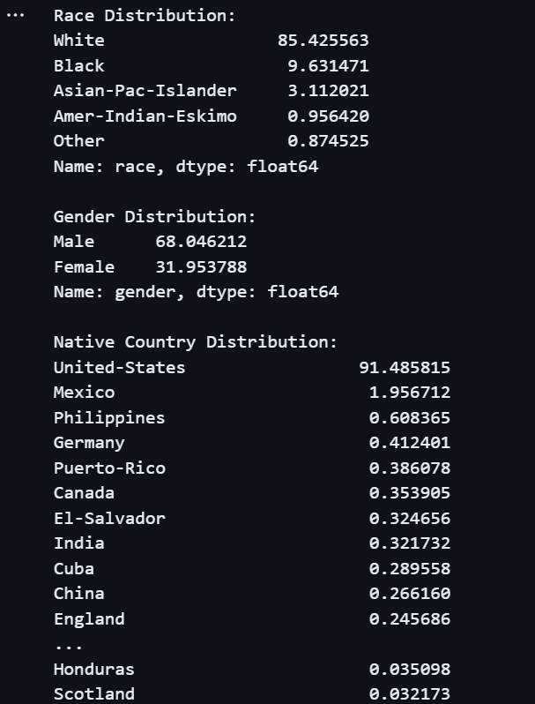
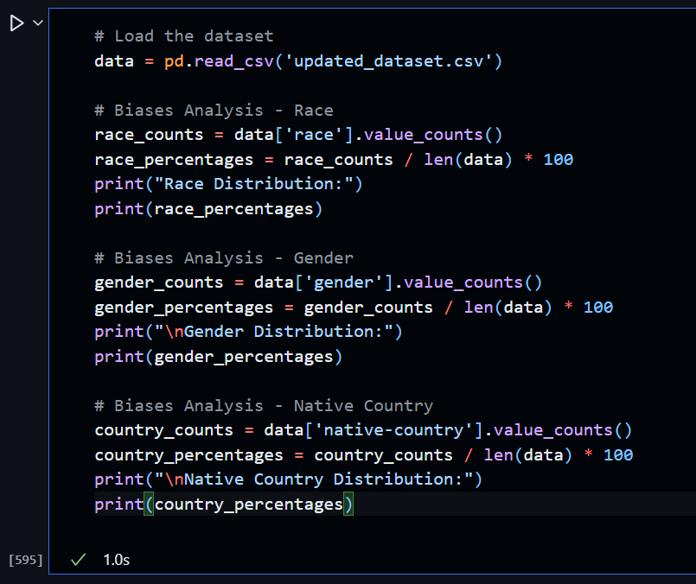
Bias Analysis

Slide 7
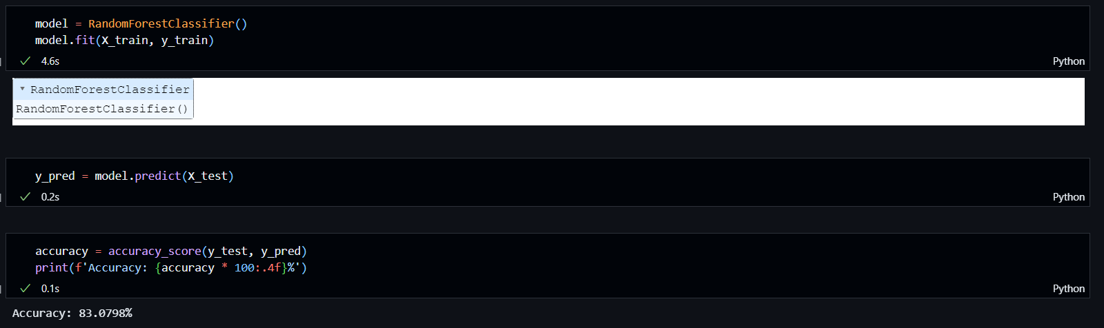
Accuracy (with gender and racial bias mitigation)

Slide 8
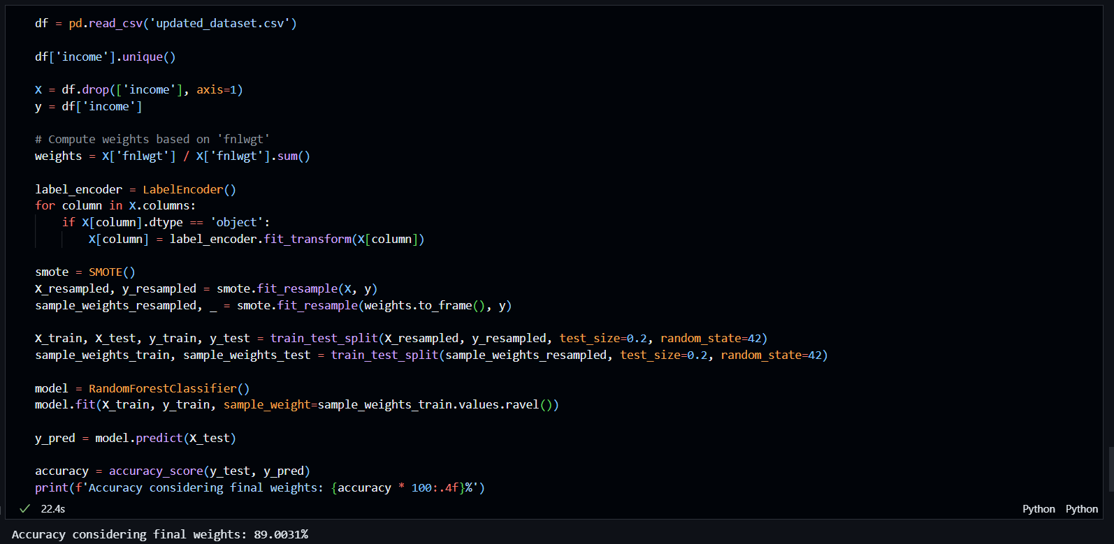
Final Accuracy (Normalizing final weight)

Slide 9
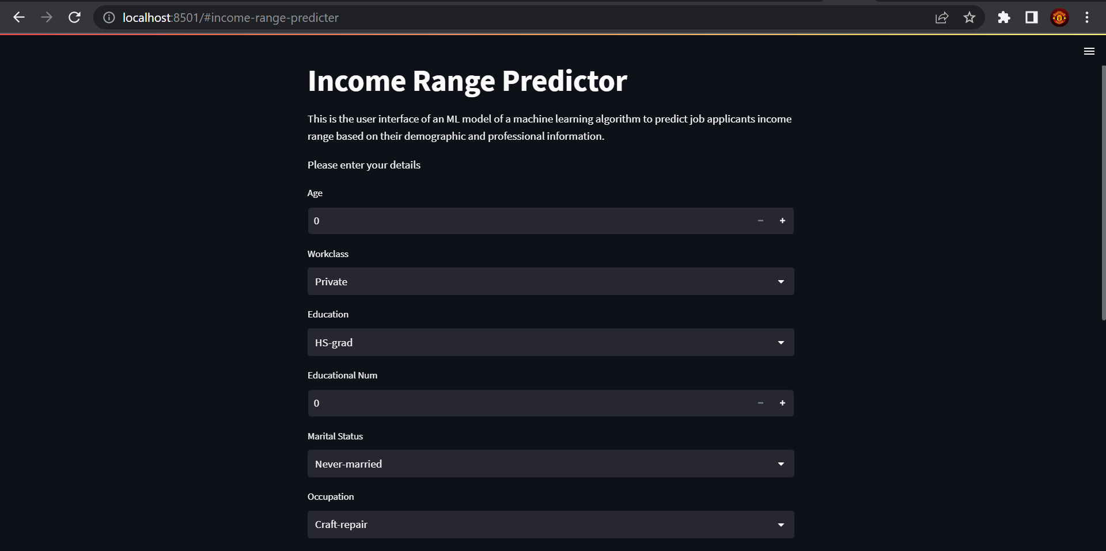
User interface

Slide 10
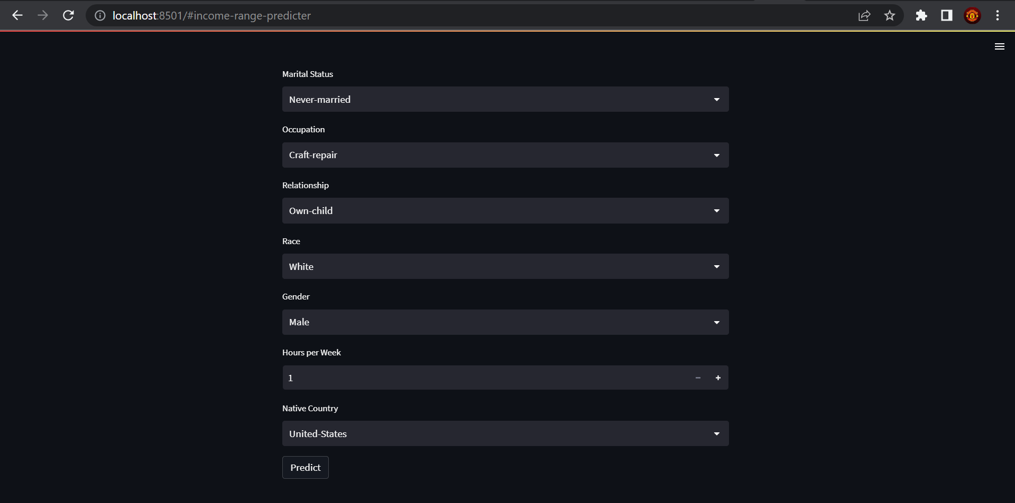

Slide 11
Done by Sahiti Dharmavaram and Aryan Sethi (21BCE0710 & 21BCE0704)
Thank you!!

